Slide 1
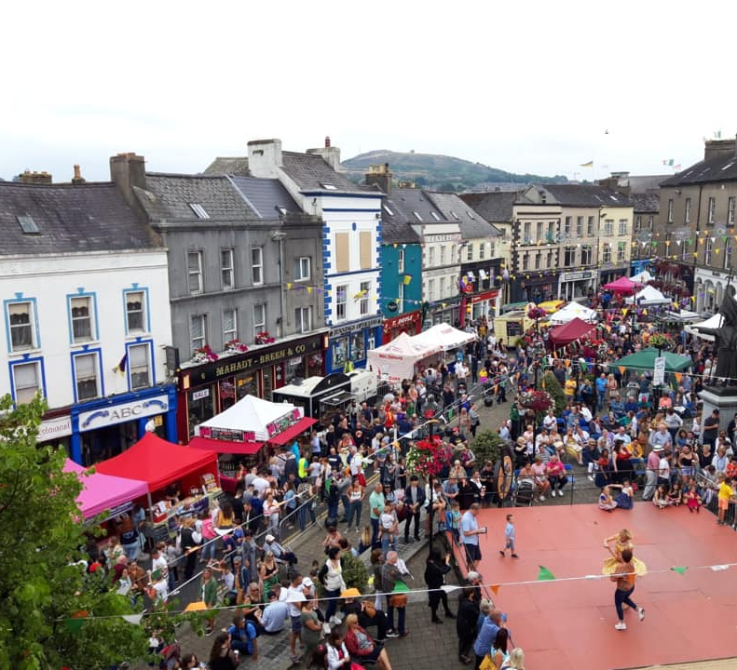
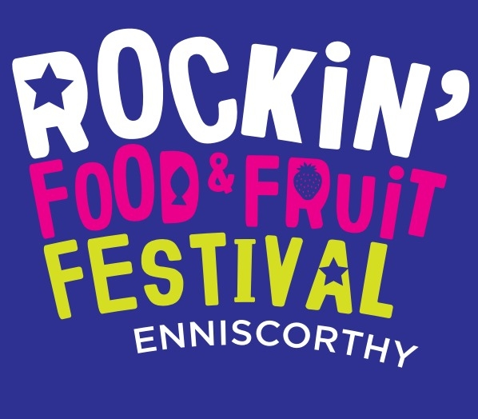
Brand Partner Proposal 2022

Slide 2
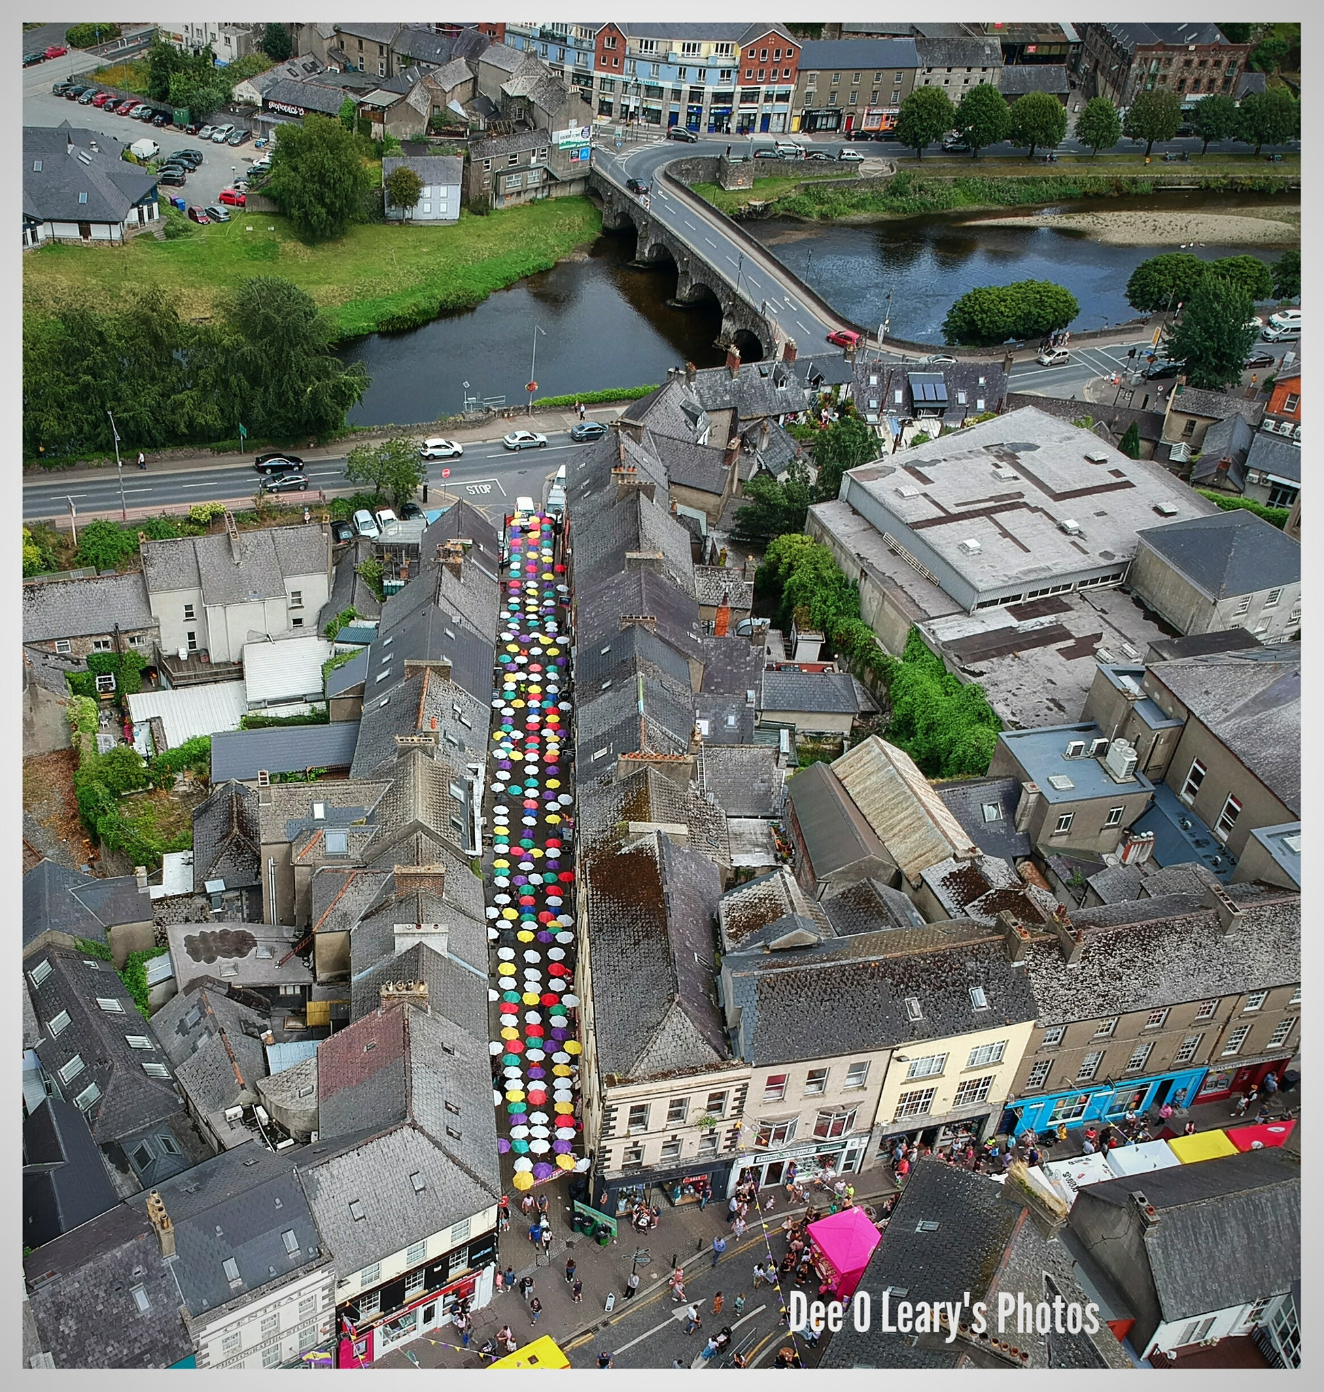
Festival Overview
The Rockin’ Food & Fruit Festival is an all inclusive food, family and music festival attracting a wide range of people from around the world. The festival takes place over the August Bank Holiday Weekend (29th Jul – 1st Aug) in the historic town of Enniscorthy attracting over 100,000 festival-goers in 2019
In addition to the 80 artisan food and craft stands we also have a gig trail with over 50 Irish & International gigs playing in every pub and the main Market Square throughout the weekend

Slide 3
Festival Objectives
Food, Music, Family, Community, Connectivity
Building relationships with the wider community by supporting Wexford businesses
Showcasing the best of Wexford and Irish food and craft
Community engagement through enlisting volunteers from all ages
Family workshops and entertainment for children right up to 100 years of age

Slide 4
The Team
Festival Chairman: Eric Barron
Festival Treasurer: Emma Fox, AIB
Committee Members: Maree Lyng, Richard Cotter, Jimmy Gahan, Eamonn Doyle
Event Management & Marketing: Amanda Whitmore, AW Marketing

Slide 5
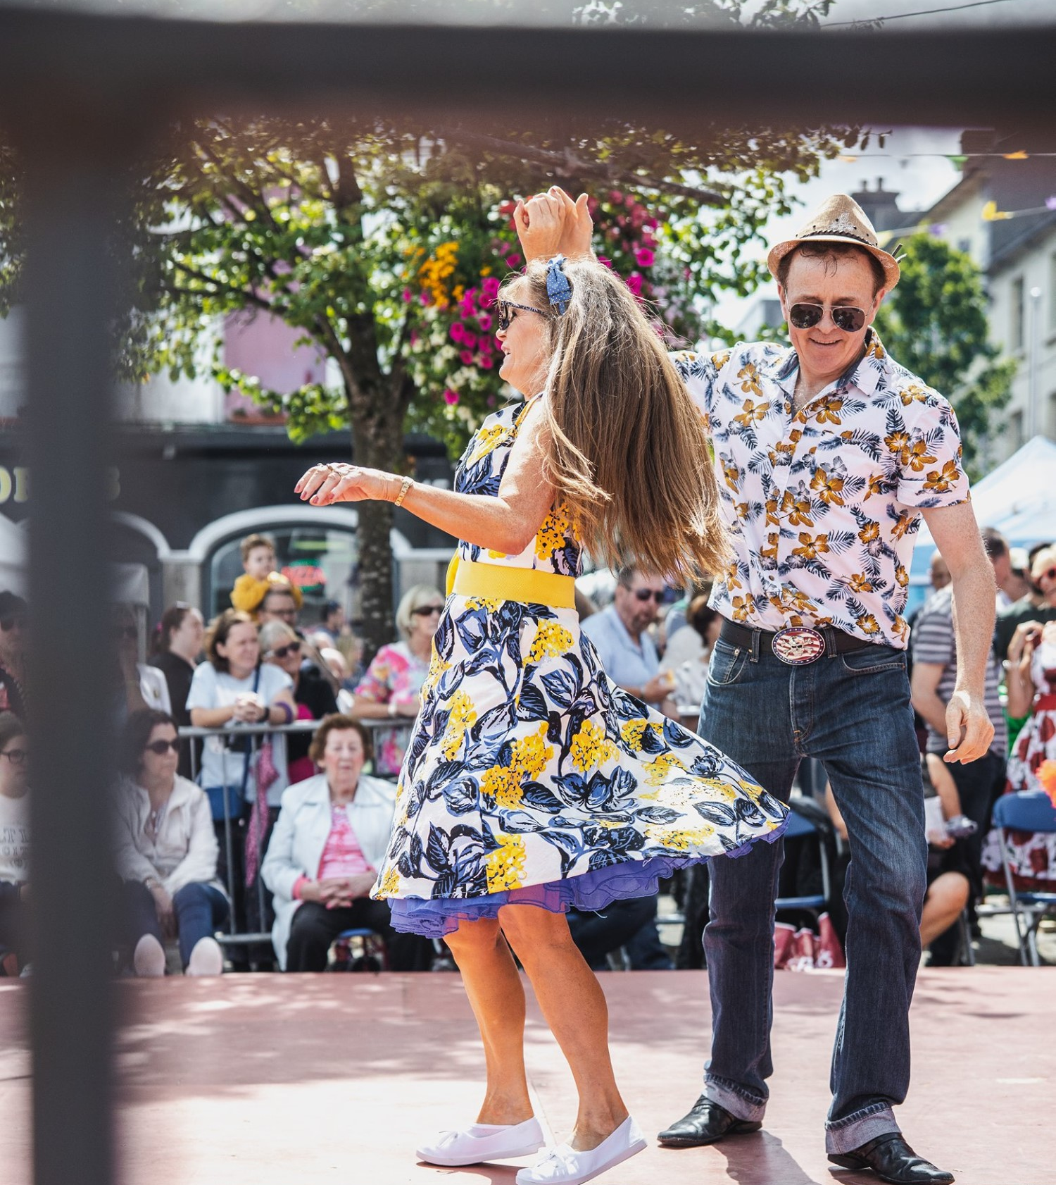
Why get involved?
Each year the festival gets bigger and better with attendee numbers growing steadily since the beginning of the festival in 2015.
Affiliate your brand with Wexford’s largest festival that generates a great atmosphere in Enniscorthy
Exposure across our Social Media Channels, in 2019, we had a Social Media reach and engagement of over 1million

Slide 6
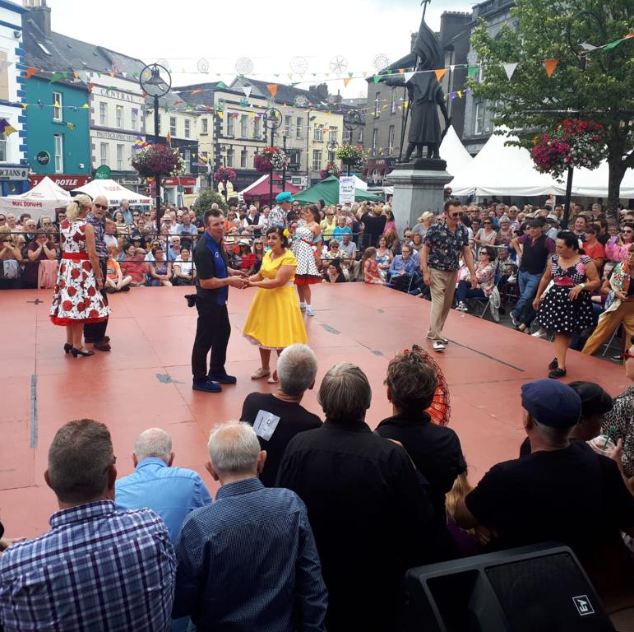
Why get involved?
National Press coverage in publications such as RTE Guide, Image magazine, Irish Farmers Journal, The Taste, Beat 102 103, Today FM, Southeast Radio
Our marketing team are open to discussing ideas you may have to get the maximum exposure for your brand

Slide 7

Headline Drinks Sponsorship
Naming Rights on Main Stage & Dancefloor
Mentions by the musicians throughout the weekend
Exclusive branding on Main Stage
Branding inside Drinks Tent in Market Square
Exclusive branding of pre festival event in The Bailey Bar over the June Bank Holiday Weekend
Brand included in all media interviews, signage and marketing collateral
Brand presence on Web & Social Media Channels
Photo opportunity for media at festival launch

Slide 8
Food Marquee Partner (€6,000)
Exclusive branding in the Food Marquee
Logo Usage on Chef Apron & Tents and mentions by Celebrity Chefs Kevin Dundon, Edward Hayden and other chefs
Brand mentions on all festival media interviews
Presence on website & social media channels
Included in all marketing collateral, chefs uniforms and aprons
Opportunity to host your own competition, prize, competition on Social Media.
Invitation to Festival Opening Event on Fri. 29th July in Enniscorthy Castle

Slide 9
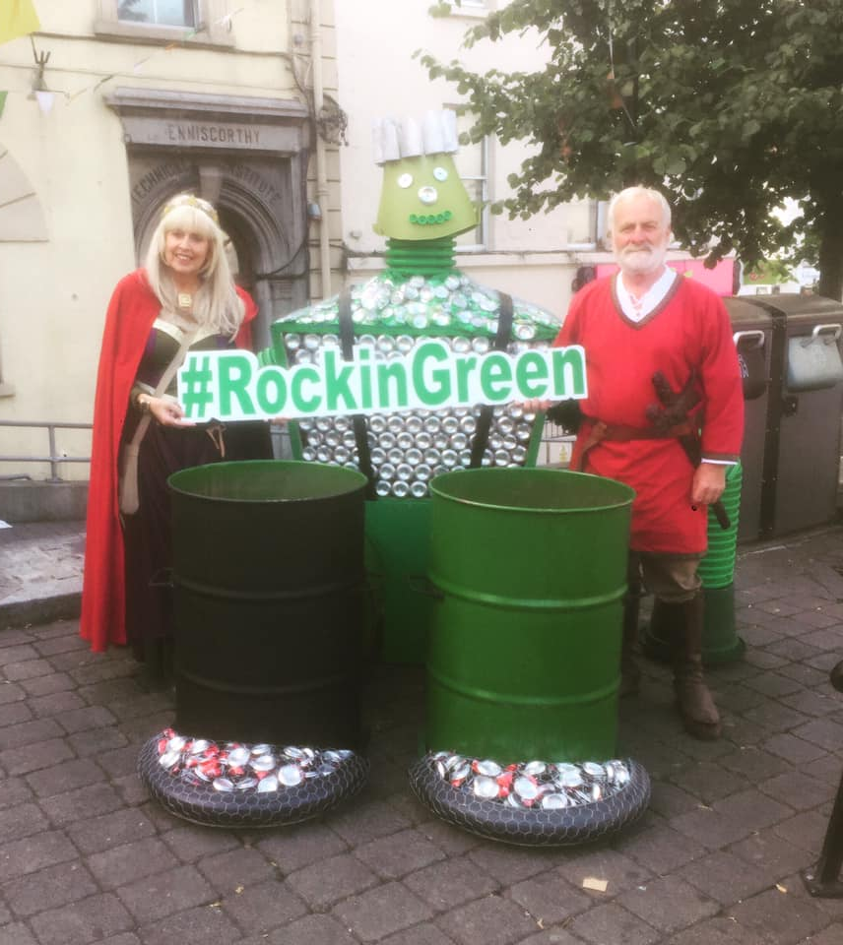
Go Green Brand Partner (€4,000)
Logo on ‘Go Green’ materials throughout the town for the duration of the event
Logo on reusable coffee cups distributed at various coffee locations over the weekend (optional)
Brand included on all signage & marketing collateral
Presence on website, social media channels
Brand mention on all media interviews
Invitation to Festival Opening Event in Enniscorthy Castle
People affiliate your brand as environmentally and socially responsible

Slide 10

Social Media Partner (€5,000)
Branding on Social Media booth with branded Selfie frame
Branding on Social Media Team T-shirts
Strong presence on Social Media over the festival weekend
Branding on all Festival Marketing Collateral
Mentions in all Media Interviews
Invitation to Festival Opening Event in Enniscorthy Castle on Fri. 29th July

Slide 11
Opening Night Sponsor (€2,000)
Sponsorship of opening event of the Festival Weekend taking place in Enniscorthy Castle on Friday 28th July 2022
Branding on all marketing collateral, website, social media channels and brochure
Mentions on Social Media channels
Opportunity to run competition on Social Media
4 Complimentary Gig Tickets

Slide 12
Festival Queen Sponsor (€4,000)
Sponsorship of the newly branded Rockin’ Food & Fruit Festival Queen Event
Branding included on all marketing collateral
Mentions on Social Media channels, media interviews by Organisers and Princesses
Branding opportunity at the Festival Ball in Riverside Park Hotel
Branding on Festival Princess & Queen sashes
Invitation to Festival Opening Event in Enniscorthy Castle
4 x tickets to the Festival Ball

Slide 13
Platinum Friend of The Festival (€1,000)
Logo and link to website on www.rockinfoodandfruitfestival.ie
Recognised supporter of the festival
Logo in all marketing collateral – website, brochure
Social Media mentions
Invitation to Festival Opening Event in Enniscorthy Castle

Slide 14
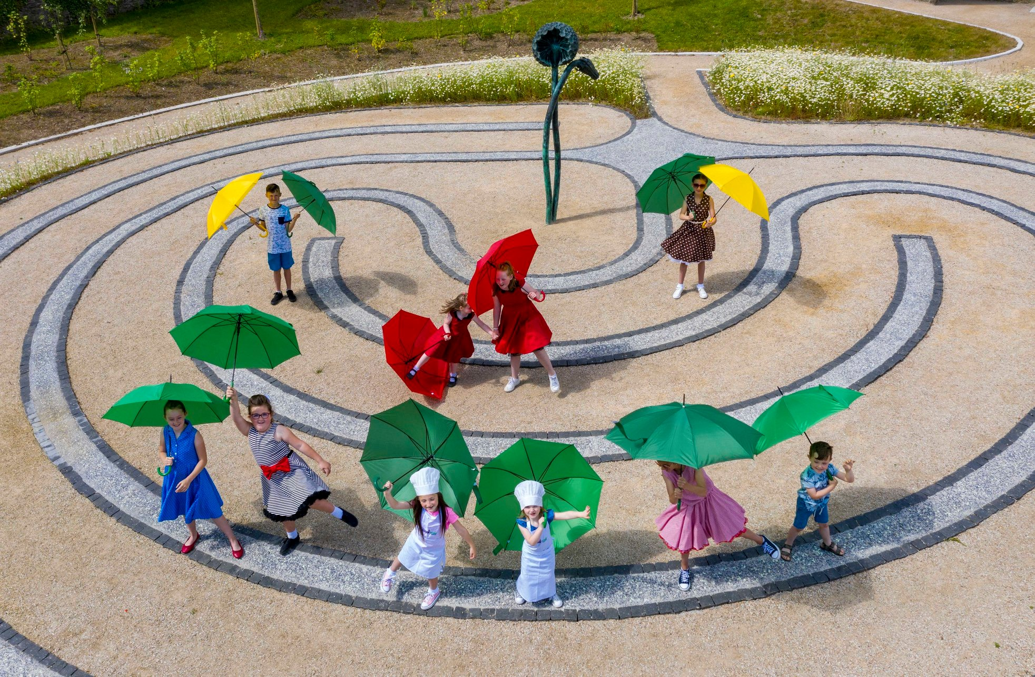
Friends of The Festival
Gold €500
Logo, name and website URL on website as Friend of the Festival
Social Media mention
Silver €250
Name & website URL on website as Friend of the Festival
Social Media mention
Bronze €100
Name on website as Friend of the Festival
Social media mention

Slide 15

Contact
Amanda Whitmore
info@amandawhitmore.ie
087 4419140
Suzanne Connolly
rockinfestival@amandawhitmore.ie
Festival Funders:

